Slide 1
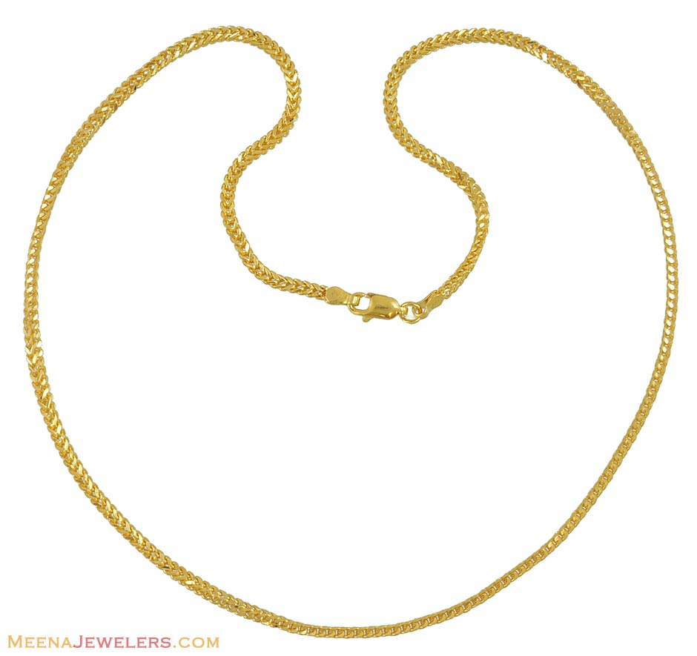
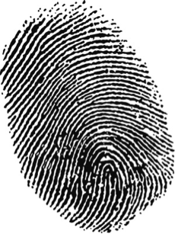
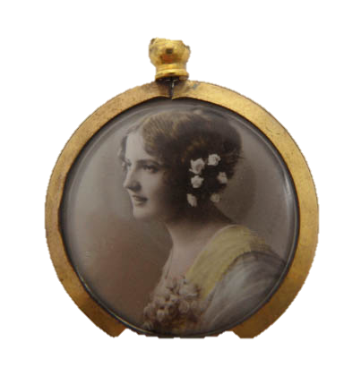
What are these objects?

Slide 2
What do these clues suggest about William’s murder?
pocket
miniature
thumbprint

Slide 3
Who is responsible?
Victor
Justine
Elizabeth

Slide 4
Characters’ point of view
Victor

Slide 5
Characters’ point of view
It’s all my fault…
It’s not my fault …
I’m totally innocent …
I feel so guilty …
I should have …
I shouldn’t have …
I feel …
I think …
I wish …
If only I hadn’t …
If only I had …

Slide 6
My name is …
I feel …
because …
I wish …

